Slide 1
Moonboard Climbs
Difficulty Classification
Devan Richter Davi Aragao
GitHub: https://github.com/davaragao/ML_Project_Climb

Slide 2
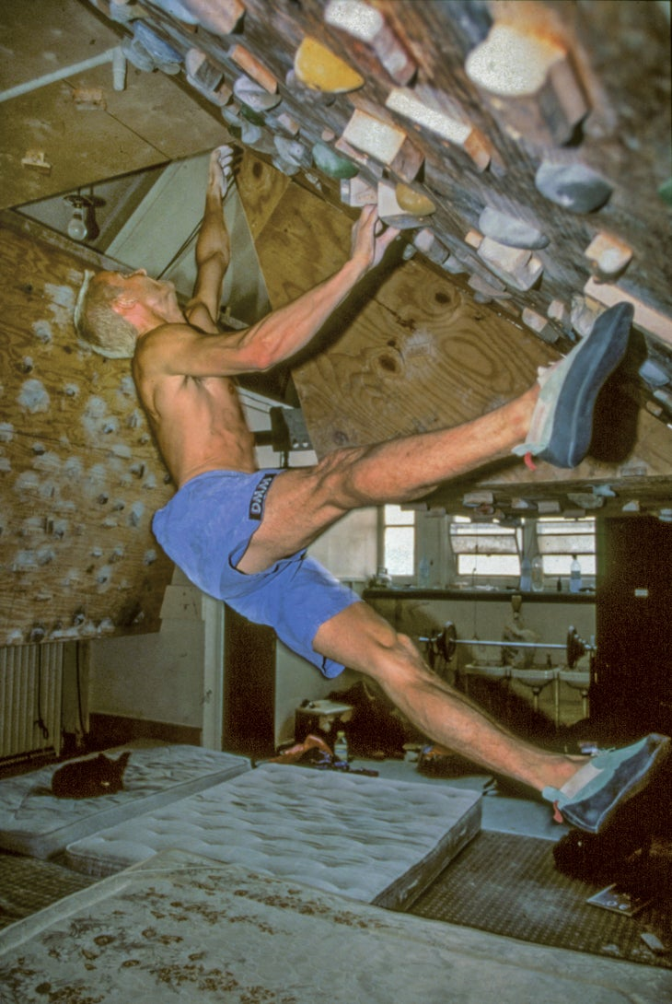
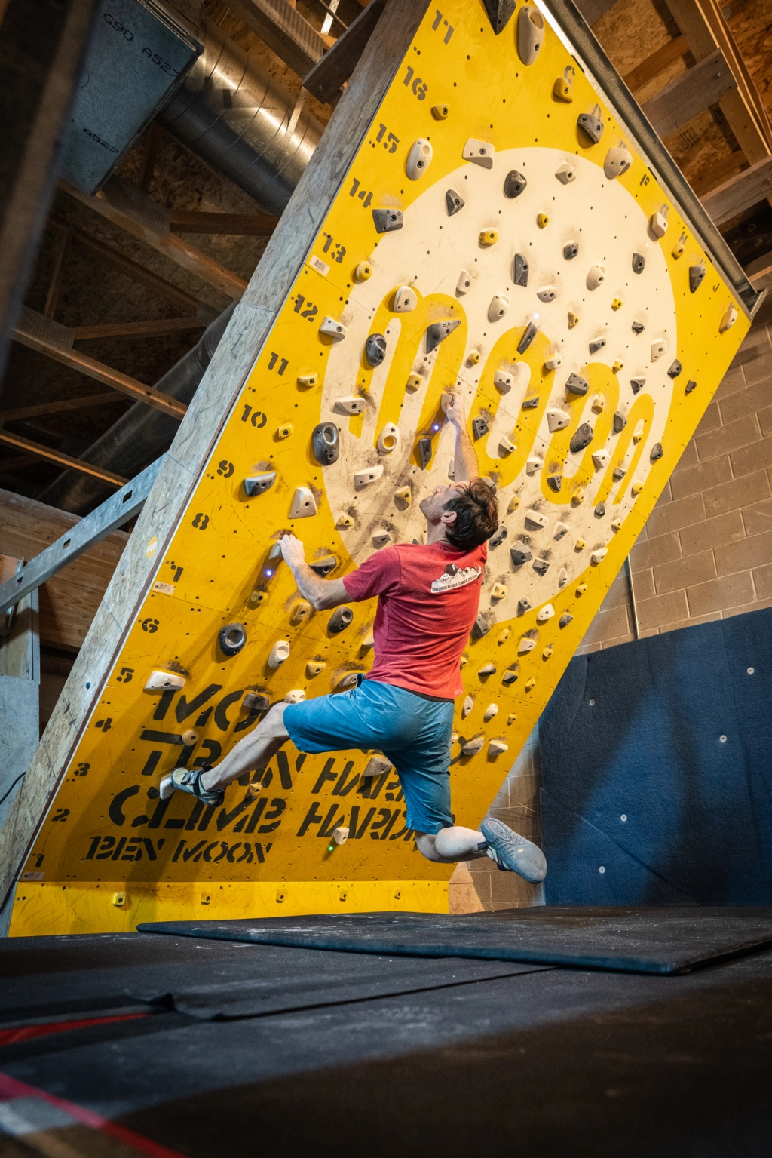
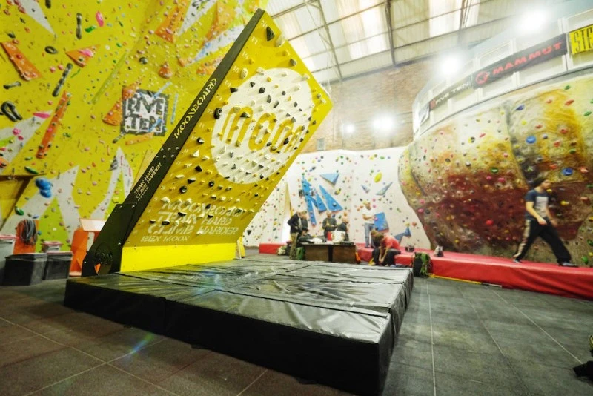
Moonboards
Originally founded in the 1990's, the School Room became the hardcore indoor training hub for some of Britain's most talented climbers
In 2005, Ben Moon developed a standardised wooden training board. Set at 40° with a specially designed set of resin holds called the MoonBoard.
Now available all over the world. Standardized: angle, holds, and problems. Controlled via an App

Slide 3
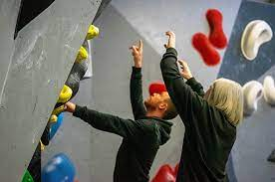
The Problem
How to classify the difficulty of a climb without having climbed it?
Why?
To assign grades if one isn’t given
Assistance for generating new climbs
For standardizing grades across different markets
Why is grading difficult? Grades are very subjective:
Climbers have different strengths (finger, core, technique, upper body, flexibility, coordination, etc.)
Climber morphology (height, wingspan, weight etc)
Regional grading preferences (sandbagging, outdoor climbing affinity)
Hard to grade what you can’t climb, for lack of comparison

Slide 4
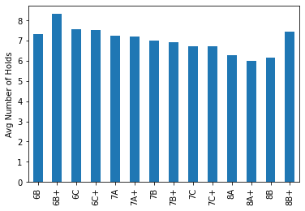
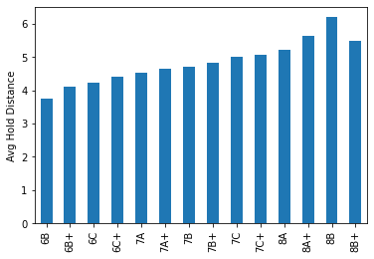
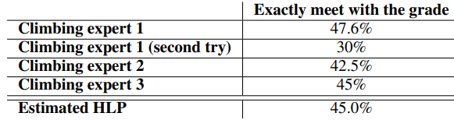
Assumptions/Hypotheses about data
Number Holds vs Grade
Human accuracy is between 30 and 45%
Distance between holds is a strong predictor of grade
Harder holds increase in frequency with grade
Difficult problems have fewer holds
Hold Distance vs Grade
Source: http://cs230.stanford.edu/projects_spring_2020/reports/38850664.pdf

Slide 5
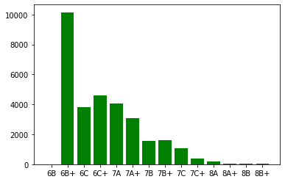
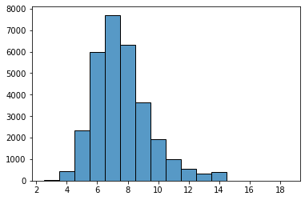
Exploratory Data Analysis
Grade Distribution
Primary source data based on MoonBoard Web Scraping
Total Observations: 30,636
Features include:
Climb Number
Hold positions for route sequence
Number of times route was climbed
Web URL & Setter profile
Grade (Our target variable)
Secondary data source with hold difficulty by position
Outlier data removed based on total hold count
Total Hold Distribution

Slide 6
Feature Engineering & Transformations for DNN
Hold Coordinates
Hold Difficulty by Hand
Difficulty Sequences
Left Hand: 3
Right Hand: 7
Min: [ 3.0, 3.0 , 5.0 ]
Avg: [ 3.5, 5.0, 5.5 ]
Max: [ 4.0, 7.0, 6.0 ]
[ 8 , 13 ]
Convert hold location sequences to difficulty sequences
Profile route based on difficulty at start, middle, and end
Store attributes including number of holds and most difficult hold
Analyze hold distances across MoonBoard
Group target variable

Slide 7
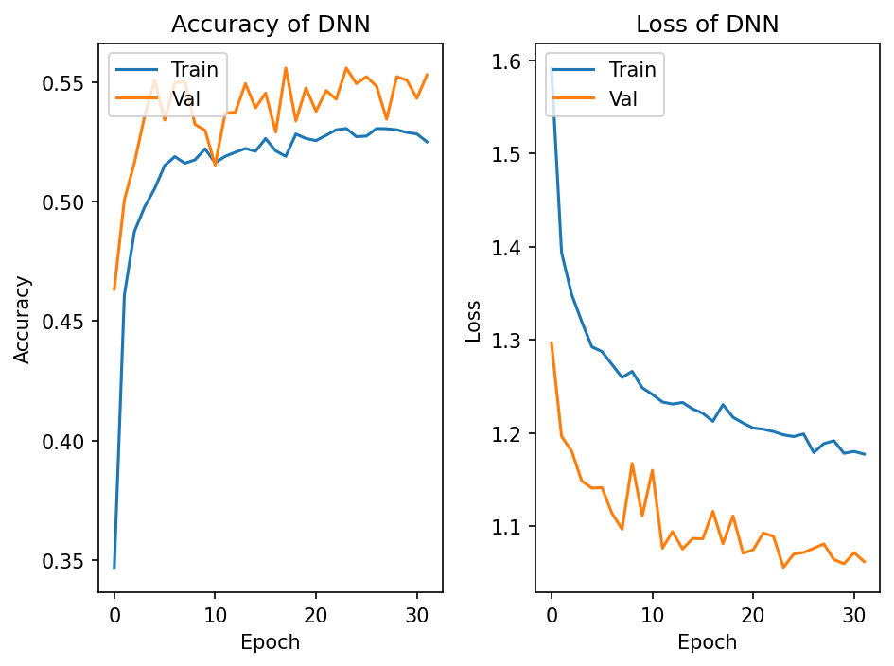
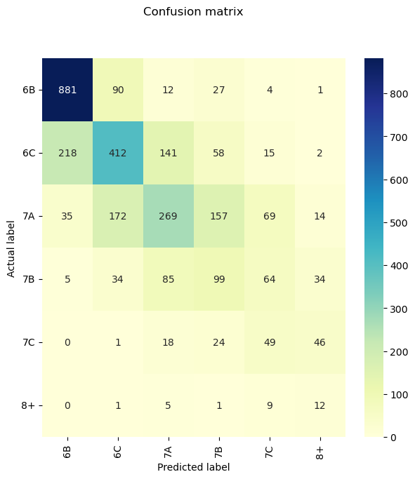
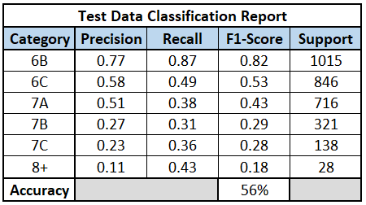
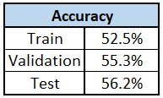
DNN Results
Input layer, 3 hidden layers, output layer
Dropout layers at 0.2 to prevent overfit
Training halted at 32 epochs based on early stopping
Adam optimizer and performance scheduling

Slide 8
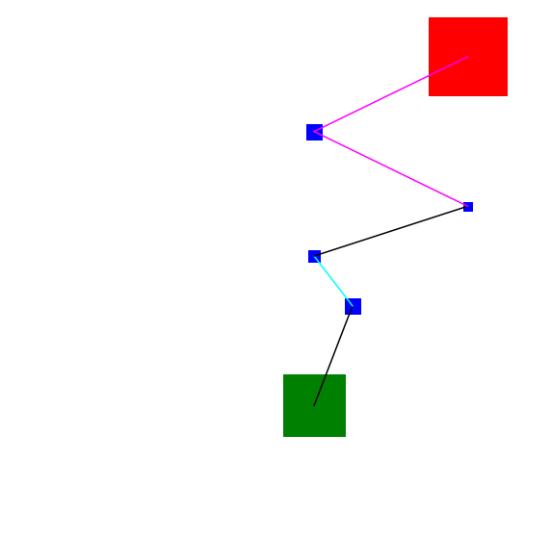
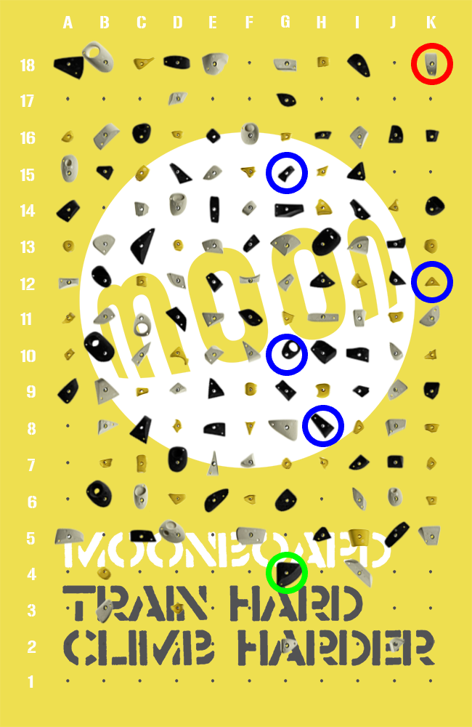
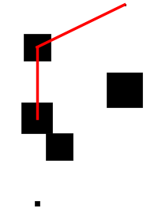
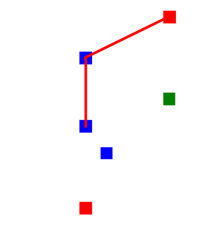
Feature Engineering & Transformations for CNN
Scraped Data in JSON:
'start': [[6, 3]],
'mid': [[7, 7], [6, 9], [10, 11], [6, 14]],
'end': [[10, 17]],
Square Colors
{Green==Easy, Blue==Avg, Red==Hard}
Square Size
Scaled proportionally by difficulty of hold
Line Colors
{Closest Hold is Far==Red}

Slide 9
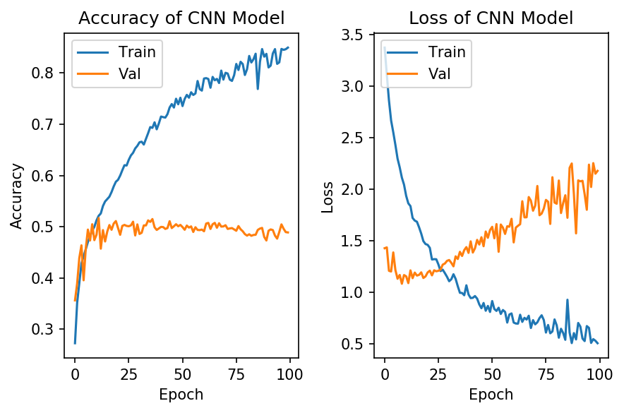
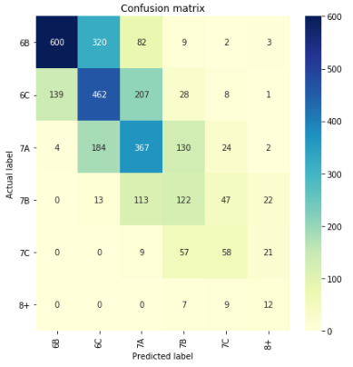
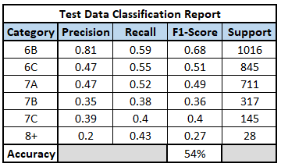
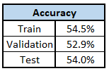
CNN Results
Overfitting Past 15 epochs
Input layer, 4 Conv2D/4MaxPooling 2D layers, output layer
Dropout layers at 0.5 to prevent overfit
Training halted at 12 epochs based on early stopping
Adam optimizer and performance scheduling

Slide 10
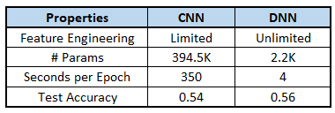
Model Selection: DNN
More flexible in adding new features
Less parameters
Faster Training
Slightly better performing

Slide 11
Future Work
Better data cleaning (removing “impossible” climbs, removing circuits, removing rule-based climbs (ie. hands only, no matching, etc))
Classifying holds based on use: hand only, foot only
Integration with Moonboard App for making the building of a climb less time consuming
Build function for encoding climbs into movement sequences for use in RNN/LSTM model
Hand sequencing to better approximate hold difficulty
Combine CNN model output as DNN input feature

